Slide 1


Sky Walkers
ONLINE CAR SALE MANAGEMENT
SYSTEM

Slide 2


About Us
We are the TEAM SKYWALKERS presenting our system Sky Motorhub
Team Members
Theoda Hettiarachchi – Leader
Samathri Abhayapala
Dilekha Dissanayaka
R.A.Kanishka Nadushan Ranasinghe
Sadeep Sachintha
Arshad Hameem
R.M.D. Arundethie Wijerathne
Neranju Chathumina
K. Rukshan C. Wijewickrama

Slide 3

The Problems
General public must defenitely visit the sale for most of the inquiries
Growing need for online Businesses Transactions
Selling a car of the 3rd party is done more physically
Maintenance record keeping is done manually

Slide 4
Our Solutions
Providing an Online System
To reduce manual work to manage all the information and make our work easy.
Providing a Database Structure
To manage the details of inventory, sales, customers, car models and car owners.
Providing Progress Charts and Reports
Charts and graphs help people process and remember data quickly.
Provide superior customer service
They can buy or sell vehicles from anywhere in the country for favourable prices.

Slide 5

Our Business Model
We bridge the gap between manual and online vehicle sales.
This module will allow a person to look for a vehicle they desire to buy or to post an advertisement about a vehicle they desire to sell and provide the necessary details to proceed for the payment. The current system registers and hold all the data of the Sky Motor hub.

Slide 6

Our Mission is to be an industry leader in providing unmatched quality automotive products and services.
We aim to provide our customers
with a top-rate sales experience

Slide 7

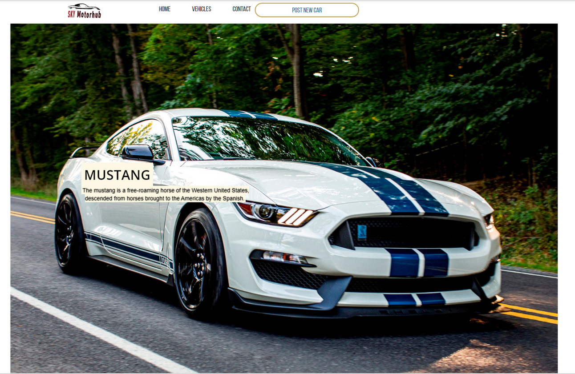
Proposed UI Design
We are a customer-centric business.

Slide 8
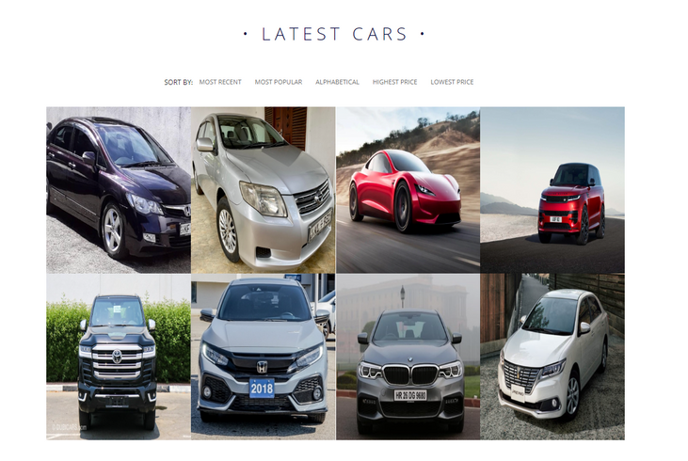
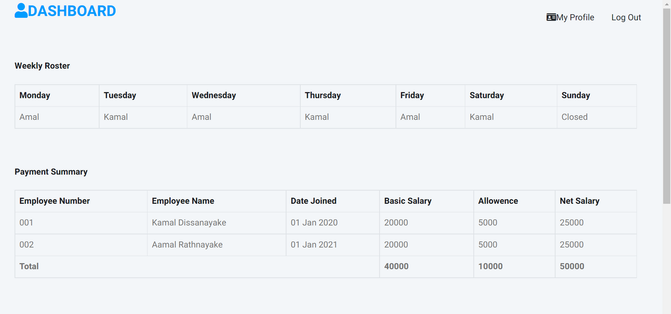
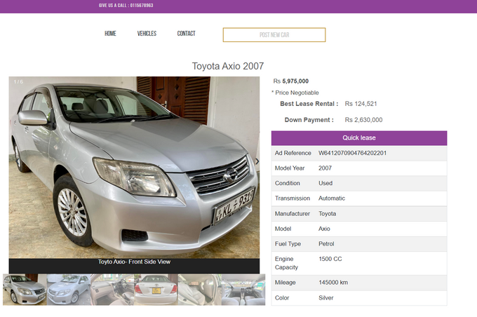
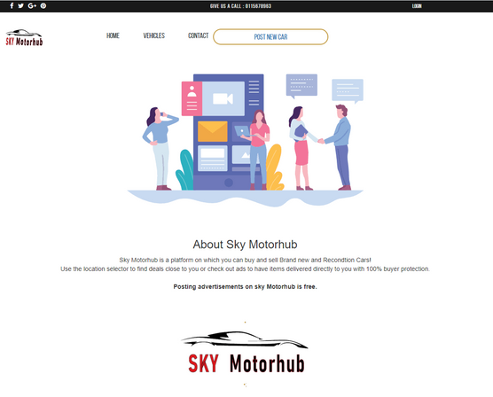
Our System Designs

Slide 9
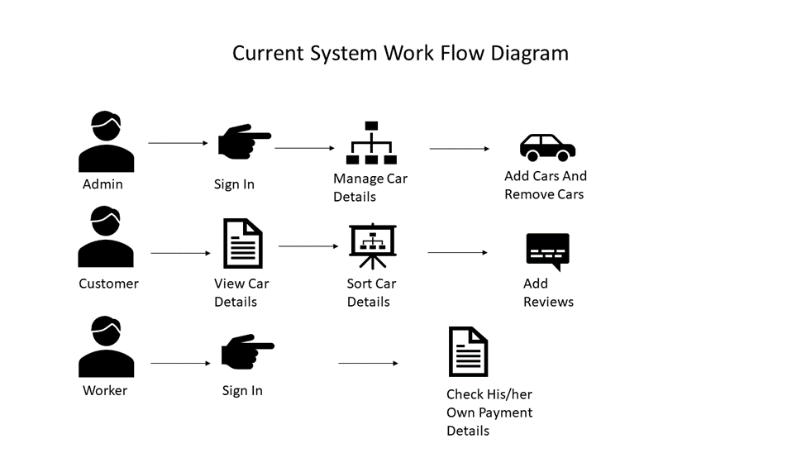
How the Proposed System Works

Slide 10
Contact Us
Phone Number
0115678963
Reach out to us for inquiries
or comments.
Email Address
helloskymotorhub@gmail.com
Website
SkyMotorhub.lk

Slide 11
Thank You!

